Slide 1
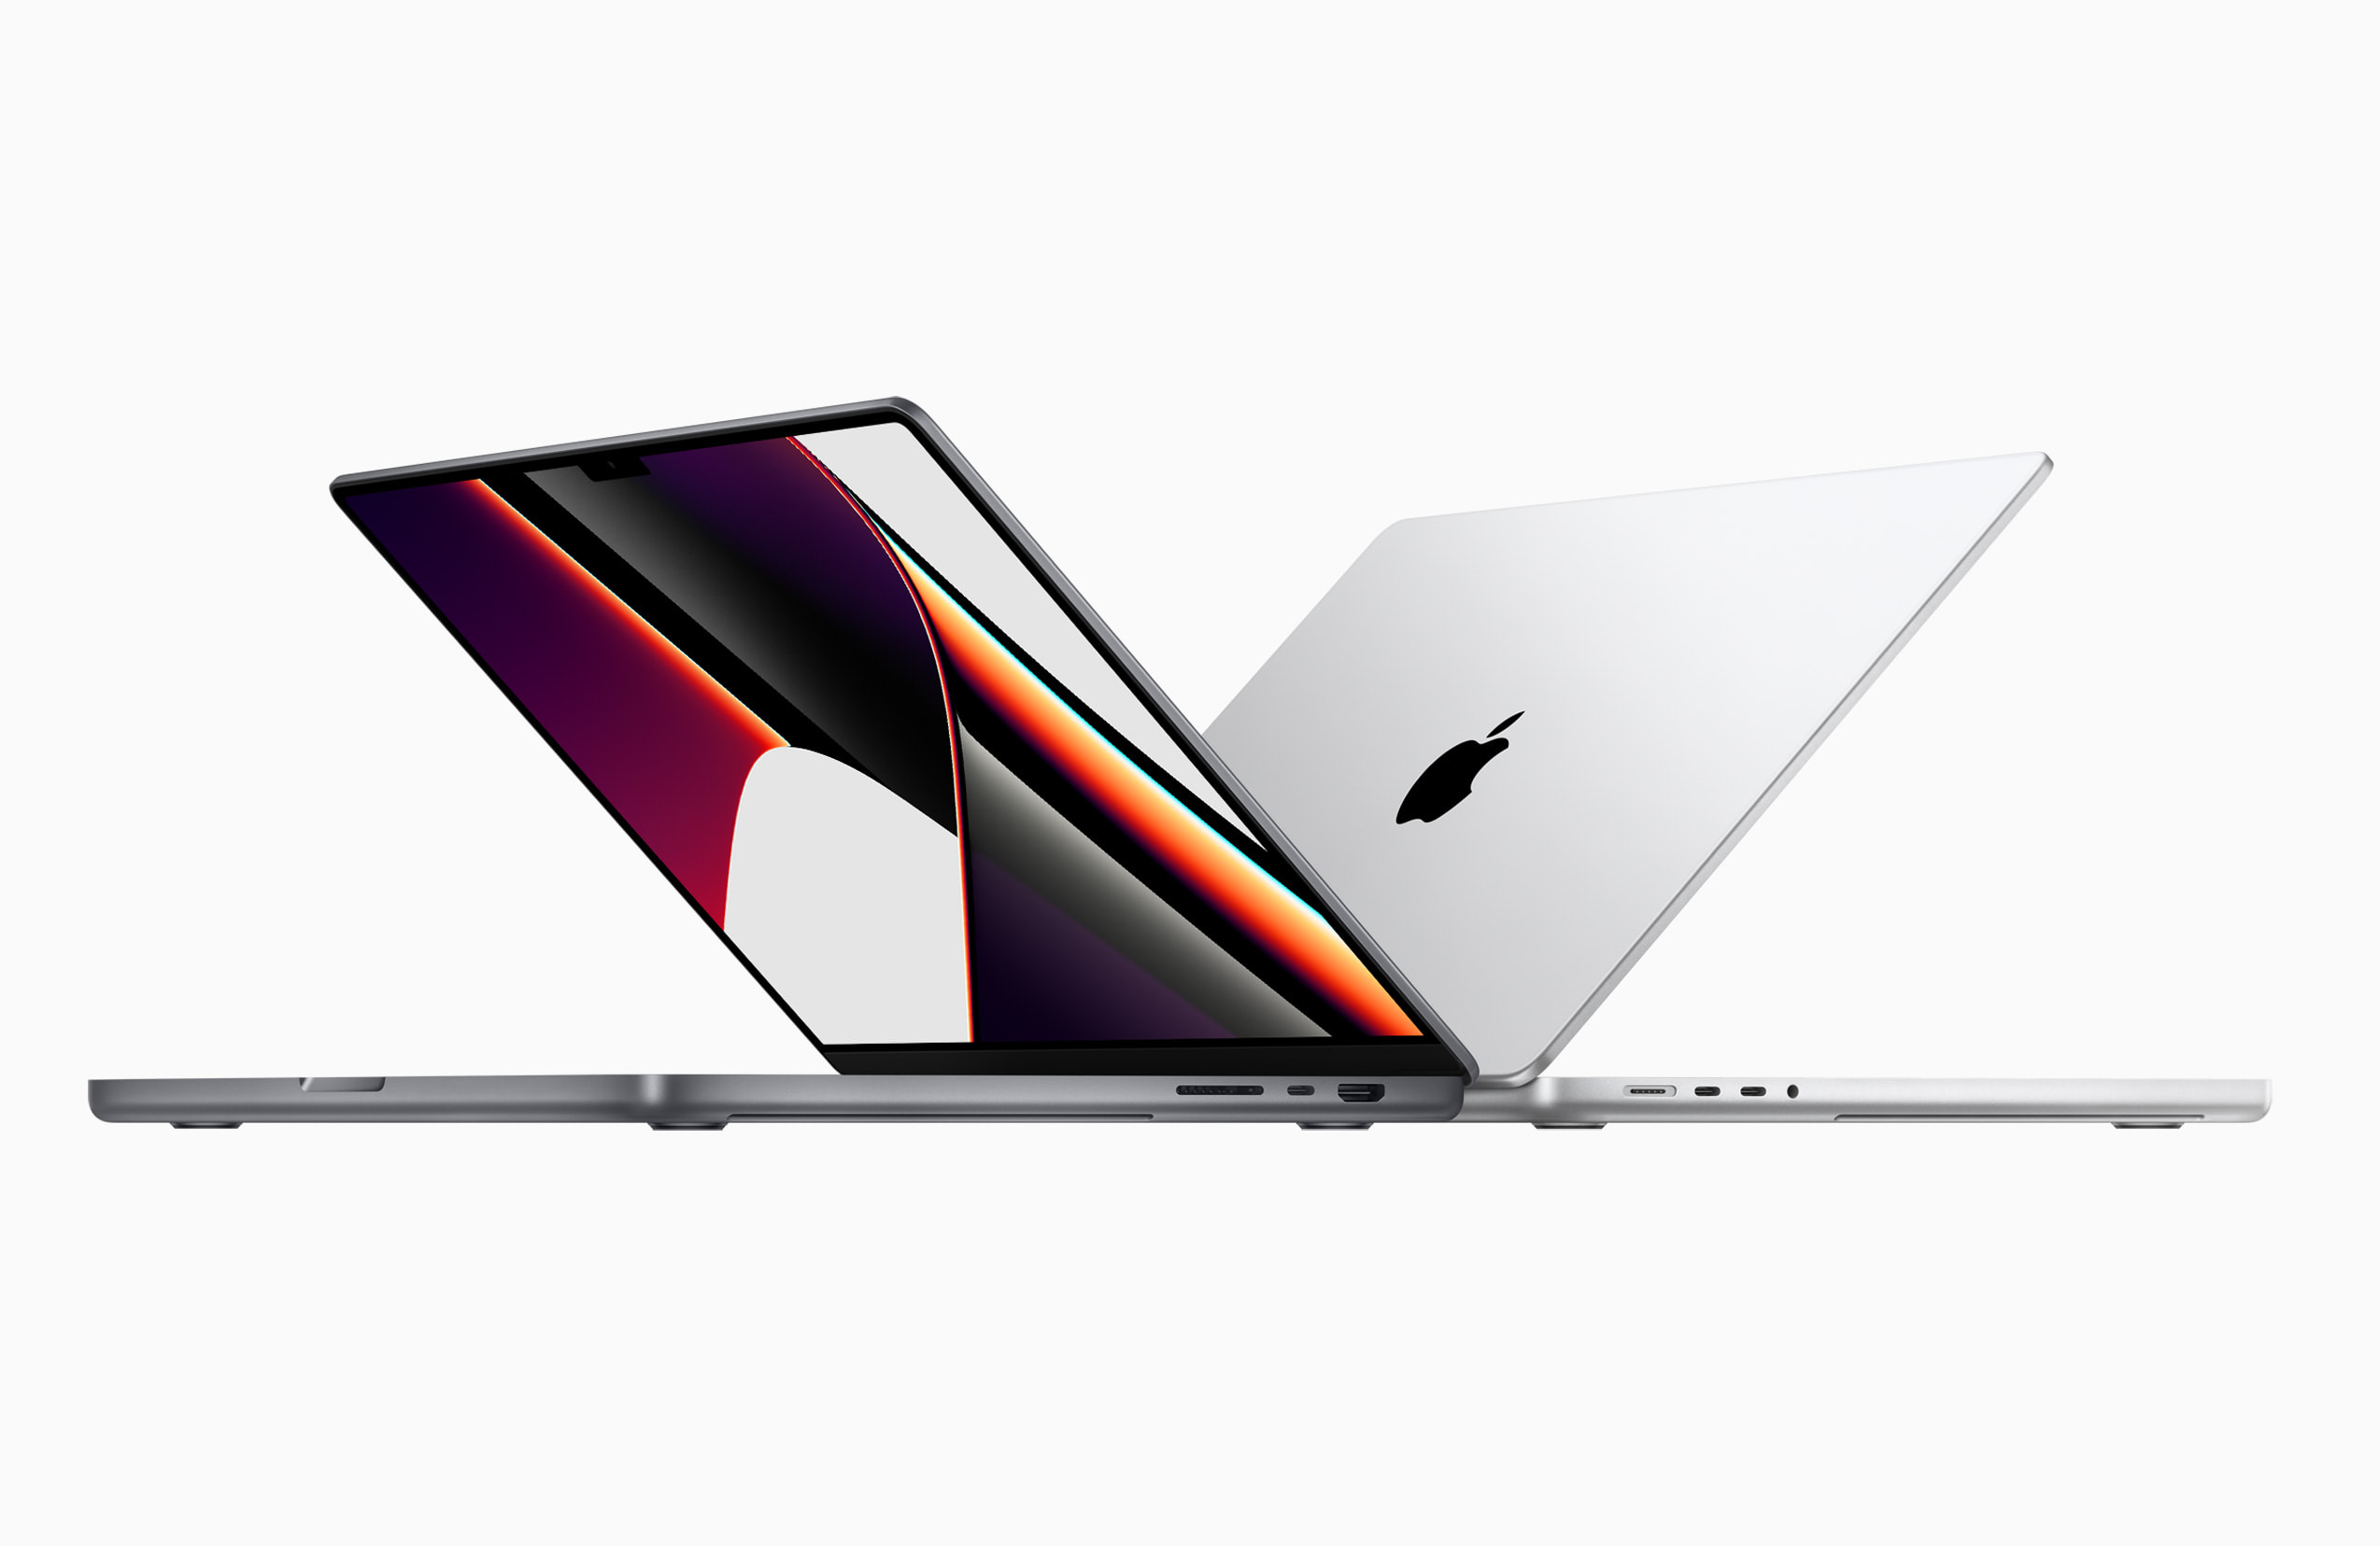
Eniac`s strategy
GROUP 4
Zhanna Borodaeva

Slide 2
QuestioN 1. Is Magist a good place for tech products?

Slide 3
What categories of tech products does magist have?
# | Category Name | Category
1 | audio | tech
2 | auto | tech
3 | air_conditioning | tech
4 | consoles_games | tech
5 | dvds_blu_ray | tech
6 | home_appliances | tech
7 | electronics | tech
8 | home_appliances_2 | tech
9 | small_appliances | tech
10 | computers_accessories | tech
11 | pc_gamer | tech
12 | computers | tech
13 | small_appliances_home_oven_and_coffee | tech
14 | portable_kitchen_food_processors | tech
15 | signaling_and_security | tech
16 | tablets_printing_image | tech
17 | telephony | tech
18 | fixed_telephony | tech
Name of Category | Number of Categories | Percent
Tech categories | 18 | 24%
Other categories | 56 | 76%
Total | 74 | 100%

Slide 4
tech categories sold: 14% of all products
Products Type | Pieces | Percent
Tech Products Sold | 15946 | 14%
Other Products Sold | 96704 | 86%
All Products Sold | 112650 | 100%

Slide 5
47% - expensive tech products
AVERAGE PRICE
120.65
Category | Average Price | Price_Level | Sold Tech Products, pcs.
computers | 1098.34 | expensive | 203
small_appliances_home_oven_and_coffee | 624.29 | expensive | 76
home_appliances_2 | 476.12 | expensive | 238
small_appliances | 280.78 | expensive | 679
portable_kitchen_food_processors | 264.57 | expensive | 15
fixed_telephony | 225.69 | expensive | 264
air_conditioning | 185.27 | expensive | 297
pc_gamer | 171.77 | expensive | 9
auto | 139.96 | expensive | 4235
audio | 139.25 | expensive | 364
consoles_games | 138.49 | expensive | 1137
signaling_and_security | 108.09 | cheap | 199
home_appliances | 103.98 | cheap | 771
dvds_blu_ray | 93.74 | cheap | 64
tablets_printing_image | 90.70 | cheap | 83
telephony | 71.21 | cheap | 4545
electronics | 57.91 | cheap | 2767
Total |  |  | 15946
Price_Level | Pieces | Percentage
Expensive | 7517 | 47%
Cheap | 8429 | 53%
Total | 15946 | 100%
Expensive | Price > 120.65
Cheap | Price <= 120.65

Slide 6
39% of all sellers are technical – 25 months of sales
Year | Months
2018 | 10
2017 | 12
2016 | 3
Total | 25
Seller Type | Number | Percentage
Tech Sellers | 1192 | 39%
Other Sellers | 1903 | 61%
All Sellers | 3095 | 100%
Tech_Category | Tech_Sellers_Number
auto | 383
electronics | 149
telephony | 149
small_appliances | 105
consoles_games | 82
air_conditioning | 52
fixed_telephony | 49
home_appliances | 48
home_appliances_2 | 46
signaling_and_security | 46
audio | 36
small_appliances_home_oven_and_coffee | 15
dvds_blu_ray | 10
computers | 9
tablets_printing_image | 6
portable_kitchen_food_processors | 5
pc_gamer | 2
Total | 1192
Low level of competition in the Computers segment constitutes a probable business opportunity

Slide 7
2 094 494.26 (Total) and 83 779.7 (Monthly) USD are received by Tech sellers
Tech_Category | Revenue
auto | 592720.11
telephony | 323667.53
computers | 222963.13
small_appliances | 190648.58
electronics | 160246.74
consoles_games | 157465.22
home_appliances_2 | 113317.74
home_appliances | 80171.53
fixed_telephony | 59583.00
air_conditioning | 55024.96
audio | 50688.50
small_appliances_home_oven_and_coffee | 47445.71
signaling_and_security | 21509.23
tablets_printing_image | 7528.41
dvds_blu_ray | 5999.39
portable_kitchen_food_processors | 3968.53
pc_gamer | 1545.95
Total | 2094494.26
Sellers_Type | Totally | Monthly | Percentage
Tech Sellers | 2094494.26 | 83779.77 | 50%
Other Sellers | 2127286.62 | 85091.46 | 50%
All Sellers | 4221780.88 | 168871.24 | 100%
Expensive computers are on the 3^{d} place

Slide 8
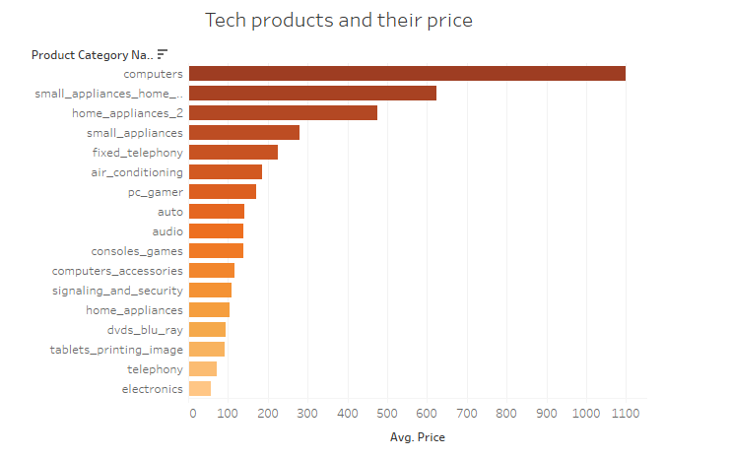
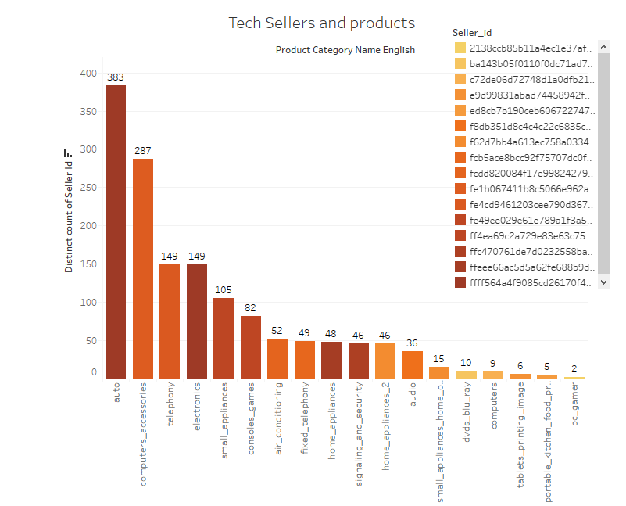
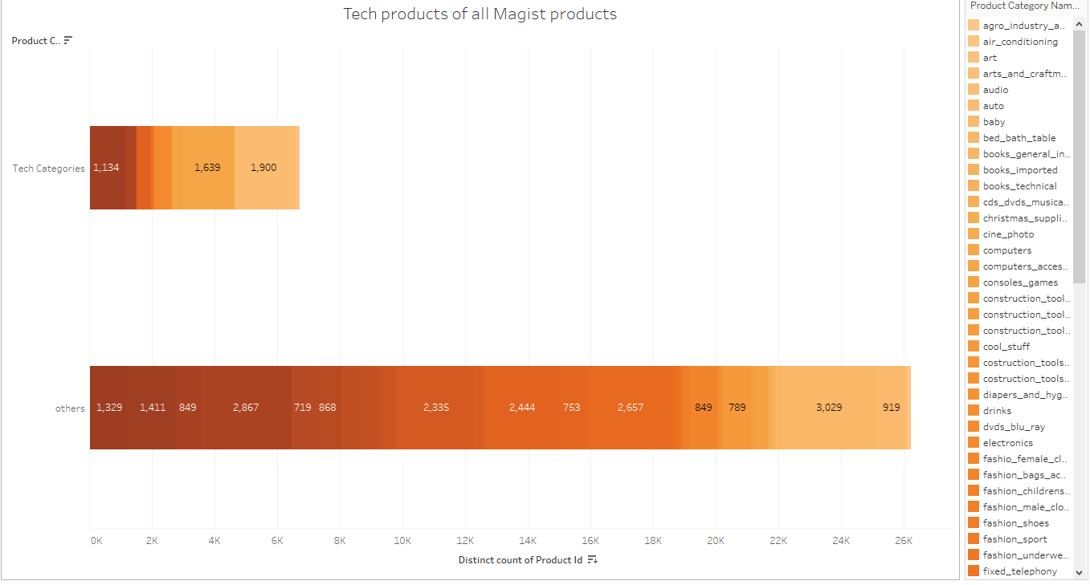

Slide 9
Conclusion 1: Yes, Magist seems to be a good place for tech products
REASONS FOR:
Tech products constitutes almost QUARTER (24%) of all Magist products
Although number of tech products is relatively low (14%), expensive tech products constitutes almost HALF (47%) of all tech products sold
Tech seller find Magist is an attractive place to work with: 39% of all sellers are technical
Relatively low competition level in Expensive Computer Niche constitutes a MARKETING OPPORTUNITY for ENIAC‘S APPLE products
QUESTIONABLE POINTS:
Whether expected sales income and profit meet the Eniac‘s financial goals?

Slide 10
QuestioN 2. Are orders delivered on time?

Slide 11
93% of ORDERs are delivered on time. Average Delivery time: 12.5 days
Delivery Status | Orders Number | Percentage
On time | 89805 | 93%
Delayed | 6673 | 7%
Total | 96478 | 100%
Average Delivery Time, days
12.5

Slide 12
Are BiG VOLUME products being delayed more often?
Big volume products are delivered later than small volume products
Delayed big volume products are delivered on average 1.7 days later
Percentage of delayed products is only slightly associated with volume: 6% - small volume; 7% - big volume
 | Status | Average delivery time, Days | Quantity, pcs | Percentage
Small Volume Products | Delayed | 32.84 | 4660 | 6%
 | On time |  | 67891 | 94%
 | Overall | 12.02 | 72551 | 100%
Big Volume Products | Delayed | 34.54 | 2749 | 7%
 | On time |  | 34897 | 93%
 | Overall | 13.17 | 37646 | 100%
AVG_Volume, cm3
12107.2
Where | Small product has volume <=12107.2 cm³
 | Big product has volume > 12107.2 cm³

Slide 13
Are Heavy products being delayed more often?
Heavy products are delivered later than light products
Delayed heavy products are delivered 2.4 days later than light products
Percentage of delayed products is only slightly associated with weight: 7% (light) and 8% (heavy)
 | Status | Average delivery time, Days | Quantity, pcs | Percentage
Light Products | Delayed | 32.90 | 5672 | 7%
 | On time |  | 81518 | 93%
 | Overall | 12.08 | 87190 | 100%
Heavy Products | Delayed | 35.32 | 1737 | 8%
 | On time |  | 21270 | 92%
 | Overall | 13.69 | 23007 | 100%
AVG_Product_Weight, gr.
2276.75
Where | Light product has weight <=2276.75 gr
 | Heavy product has weight > 2276.75 gr

Slide 14
Conclusion 2: Magist deliveres 93% of orders on TiME overall: MAGIST IS RECOMMENDED to work with
SUMMARY:
93% of all orders are delivered on time
Percentage of delayed orders is slightly associated with:
Volume: Big Volume Orders are delayed only 1 % more frequent than Small Volume orders
Weight: Heavy Orders are delayed only 1 % more frequent than Light Orders
OVERALL SUMMARY:
MAGIST IS RECOMMENDED AS A GOOD MARKETPLACE TO PROMOTE APPLE PRODUCTS AND DELIVER THEM ON TIME provided financial and other goals are met

